Slide 1
Computer Application in Engineering Design
HAND Detection using Image Processing

Slide 2
Members
Rabia
Zainab-Binte-Hassan

Slide 3
INTRODUCTION
What is an RGB Image?
An RGB image, sometimes referred to as a true color image, is stored in MATLAB as an m-by-n-by-3 data array that defines red, green, and blue color components for each individual pixel. ... The precision with which a real-life image can be replicated has led to the commonly used term true color image.

Slide 4
What is RGB in Image Processing?
The RGB Color Model
As you probably know, RGB stands for red, green, blue. ... The key to understanding RGB image processing is recognizing that an RGB image is simply a composite of three independent grayscale images that correspond to the intensity of red, green, and blue light.

Slide 5
Conversion of RGB-Skin Segmentation?
Rgb2ycbcr(rgb map) converts the RGB color space values in rgb map to the YCbCr color space. Ycbcr map is a c-by-3 matrix that contains the YCbCr luminance (Y) and chrominance (Cb and Cr) color values as columns.

Slide 6
Conversion to Gray Scale?
An RGB image can be viewed as three images( a red scale image, a green scale image and a blue scale image) stacked on top of each other. In MATLAB, an RGB image is basically a M*N*3 array of colour pixel, where each colour pixel is a triplet which corresponds to red, blue and green colour component of RGB image at a specified spatial location.
Similarly, A Grayscale image can be viewed as a single layered image. In MATLAB, a grayscale image is basically M*N array whose values have been scaled to represent intensities.
In MATLAB, there is a function called rgb2gray() is available to convert RGB image to grayscale image. Here we will convert an RGB image to grayscale image without using rgb2gray() function.

Slide 7
Conversion to Binary Image?
BW converts the grayscale image to binary image BW, by replacing all pixels in the input image with luminance greater than level with the value 1 (white) and replacing all other pixels with the value 0 (black).

Slide 8
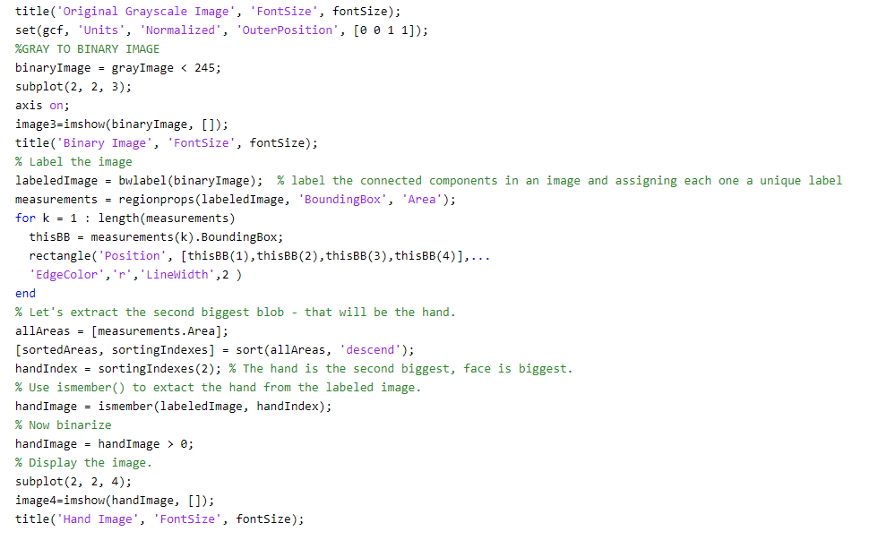
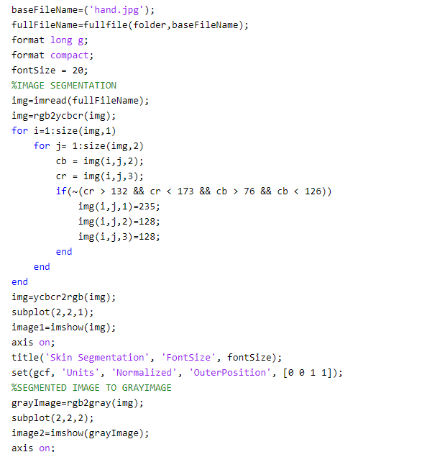
Coding:

Slide 9
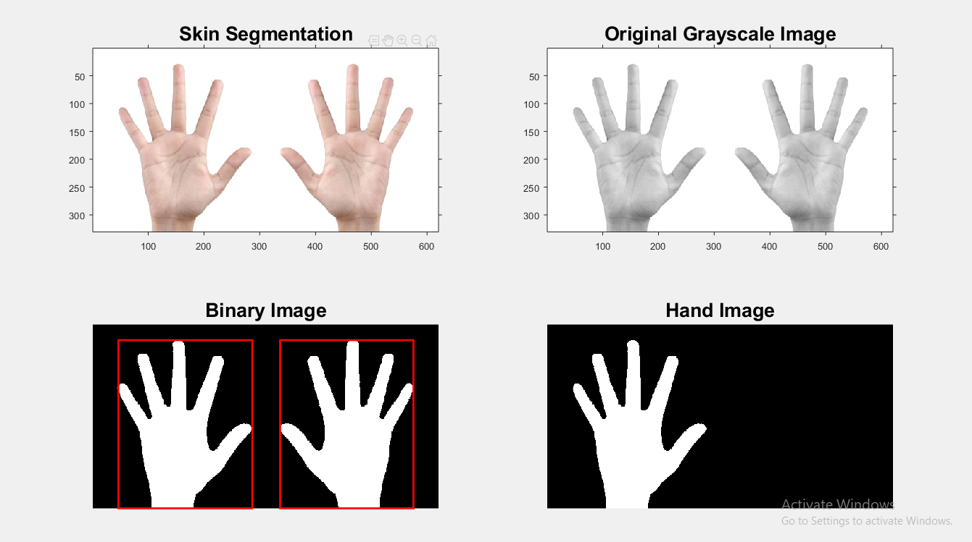
Output:

Slide 10
Daily Life Example of RGB
It is used in scanning(hand detection).
Used for security purpose.

